Slide 1

CloudChange: A Cloud-Native Framework for Dependency-Aware Change Impact Analysis
and Safe Kubernetes Deployment
CNAD Project Review-1
Date: 29/08/2026
 | Under the Guidance of Dr. Patha Srilatha Associate Professor Department of CSE, KLH CSE Bowrampet Campus
Team Members R. L. S. Giridhar - 2420030171 V. Mani Maha Lakshmi - 2420030774 B. Keerthi Reddy - 2420030774

Slide 2
Outline of Project Work
Focus
Introduction
Literature Survey
Challenges
Research Objectives
Conclusion & Future Work
References
Publications Details

Slide 3
Problem Statement
Cloud-based applications consist of multiple interconnected services, so even a small change in application code, Kubernetes configuration, Helm charts, or APIs can unexpectedly affect other services. Traditional deployment methods may not identify these dependencies and the potential risk or blast radius before deployment, which can lead to application failures and downtime. Therefore, there is a need for a system that can analyze changes before deployment, identify affected services, assess the risk, recommend a suitable Kubernetes deployment strategy, and safely rollback the deployment if the new version becomes unhealthy.
Hidden interdependencies — Developers rarely know which services (Ingress, other microservices, downstream APIs) will be affected by a given change before it's pushed.
CI/CD validates code, not risk — Existing pipelines confirm that a change builds and passes tests, but say nothing about whether the change is safe to deploy.
One-size-fits-all deployment — Changes are rolled out the same way regardless of whether they are trivial or high-risk, since there's no mechanism to differentiate them.
Failures are caught too late — Issues such as crash loops, memory exhaustion, or latency spikes are typically discovered only after real user traffic is already affected, and rollback happens manually and reactively rather than proactively.

Slide 4
Objectives
Detect configuration/deployment changes by comparing old vs. new Helm values.
Analyze dependencies among pods, services, APIs and infrastructure components.
Build a lightweight dependency map (Ingress → Service → Deployment → Pods) to identify affected components.
Compute a rule-based risk score across configuration, resource, availability, and security dimensions.
Recommend a deployment strategy (Rolling / Canary / Blue-Green) based on the computed risk.
Execute controlled Kubernetes deployment with real-time health monitoring via Prometheus.
Automatically stop promotion and roll back on failure.
Provide a dashboard visualizing change summary, risk score, blast radius, and deployment status.

Slide 5
Literature Survey
Authors | Title of the Paper | Methodology | Inferences | Limitation/Future work
Lelovic et al. (2025) | Change Impact Analysis in Microservice Systems: A Systematic Literature Review | Systematic review of research on change-impact detection, propagation, metrics and tools in microservices | Shows that a change in one microservice can propagate to other services and create ripple effects. | Existing approaches often analyze only specific impact types and need better detection, validation and multi-effect analysis.
Cerny, Goulis & Abdelfattah, 2025 | Towards Change Impact Analysis in Microservices-based System Evolution | Proposes infrastructure based on incremental software architecture reconstruction to support change-impact analysis | Demonstrates the need for system-wide analysis of how changes propagate across microservices. | The work is mainly a foundation for impact analysis; mitigation through risk-based deployment and automated rollback is not its main focus.
Chen, Wu, Yang & Zhang, 2023 | A Microservice Regression Testing Selection Approach Based on Belief Propagation | Mines service dependencies from API-gateway logs and uses propagation calculations to identify change impacts | Demonstrates that service dependencies can be extracted and used to quantify change impact and select affected tests | Focuses mainly on regression-test selection rather than deployment-risk scoring or safe Kubernetes rollout.

Slide 6
Problem Gap Identification
Existing Approach | Identification Gap in CloudChange
1. Dependency Analysis | Identifies service relationships, but does not always estimate the risk or blast radius of a change.
2. Change Impact Analysis | Finds potentially affected components, but is generally not connected directly to deployment strategy selection.
3. Conventional CI/CD | Performs build, test, scan and deployment, but lacks dependency-aware pre-deployment risk analysis.
4. Manual Deployment & Rollback | Deployment strategy and rollback often depend on manual decisions, increasing the chance of failure and downtime.
5. Monitoring Systems | Detect application problems after deployment, but do not provide a complete predict-before-deployment and safe-release mechanism.

Slide 7
Innovation, Creativity, and Novelty
Follows a complete cycle: Change → Impact → Risk → Deployment Strategy → Deploy → Monitor → Rollback
Change Impact — automatically detects what changed between old and new Helm configuration
Blast Radius — maps dependencies (Ingress → Service → Deployment → Pods) to show what else could be affected
Safe Deployment — recommends strategy based on risk: Rolling (low), Canary (medium), Blue-Green/approval (high)
Analyzes code, configuration files, container images, and Kubernetes manifests together using a dependency graph
Gives actionable recommendations — proceed, test further, or block for manual approval — not just a report
Integrates with CI/CD and Kubernetes for automated validation, health checks, and rollback
Acts as a safety checkpoint for deployments, not just a monitoring dashboard

Slide 8
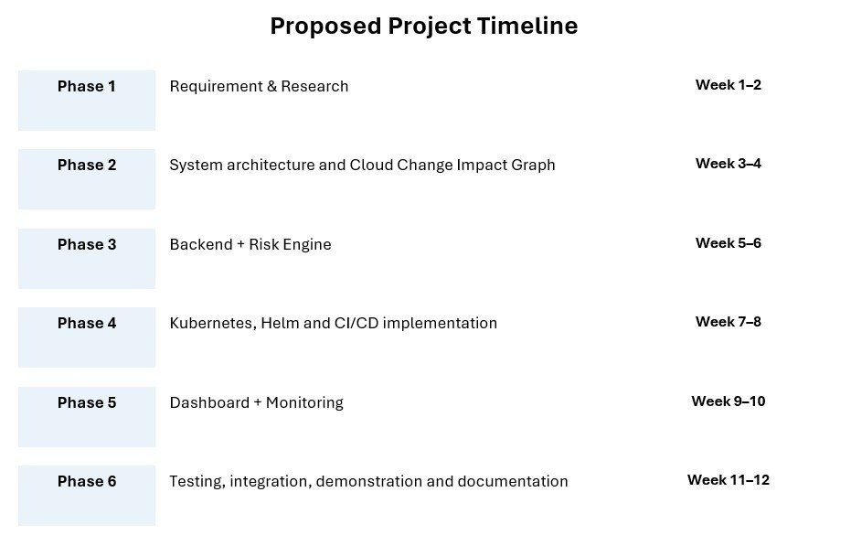
Feasibility and Project Plan
Technical: The project can be implemented using React, FastAPI, Docker, Kubernetes, Helm, GitHub Actions, Trivy, Prometheus, Grafana, Argo CD, AWS/EKS and PostgreSQL.
Operational: CloudChange provides a dashboard-based workflow for change analysis, risk assessment, deployment recommendation, monitoring and rollback, making it practical for developers.
Economic: The project can use open-source technologies and available cloud resources, making implementation suitable for an academic project.
Implementation: The system can be developed in phases, starting with change detection and dependency analysis, followed by risk scoring, Kubernetes deployment, monitoring and automated rollback.

